Slide 1
Chapter 3
Describing Syntax and Semantics

Slide 2
Attribute Grammars
Attribute grammars (AGs)
  Knuth - 1968
What is the difference?
  AG vs CFG
Copyright © 2012 Addison-Wesley. All rights reserved.
1-<number>

Slide 3
Attribute Grammars
Type Compatibility rules
  Can you define them in CFG?
Example:
  In Java
    float value = integer value
    Integer value = float value ?
  General
    Variables should be declared before they are referenced.
      Impossible to specify in BNF!
Copyright © 2012 Addison-Wesley. All rights reserved.
1-<number>

Slide 4
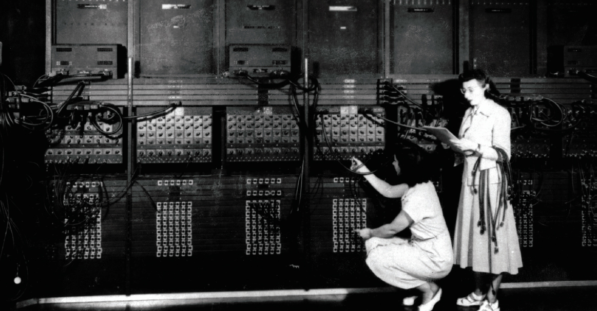
ENIAC: Two Programmers
Copyright © 2012 Pearson Education. All rights reserved.
1-<number>

Slide 5
Attribute Grammars
Primary value of AGs:
  Static semantics specification
    Is related to the syntax (not semantics)!
  Static semantics checking
    (Compiler design)
Copyright © 2012 Addison-Wesley. All rights reserved.
1-<number>

Slide 6
Attribute Grammars : Definition
Def: An attribute grammar
  is a context-free grammar G = (S, N, T, P) with the following additions:
    For each grammar symbol x there is a set A(x) of attribute values
    Each rule has a set of functions that define certain attributes of the nonterminals in the rule
    Each rule has a (possibly empty) set of predicates to check for attribute consistency
Copyright © 2012 Addison-Wesley. All rights reserved.
1-<number>

Slide 7
Attribute Grammars: Definition
Let X₀ → X₁ ... X_{n} be a rule
Functions of the form S(X₀) = f(A(X₁), ... , A(X_{n})) define
  synthesized attributes
Functions of the form I(X_{j}) = f(A(X₀), ... , A(X_{n})), for i <= j <= n, define
  inherited attributes
Initially, there are intrinsic attributes on the leaves
Copyright © 2012 Addison-Wesley. All rights reserved.
1-<number>

Slide 8
Attribute Grammars: An Example
Syntax
  <assign> -> <var> = <expr>
  <expr> -> <var> + <var> | <var>
  <var> A | B | C
actual_type: synthesized for <var> and <expr>
expected_type: inherited for <expr>
Copyright © 2012 Addison-Wesley. All rights reserved.
1-<number>

Slide 9
Attribute Grammar (continued)
Syntax rule: <expr> → <var>[1] + <var>[2]
Semantic rules:
<expr>.actual_type ← <var>[1].actual_type
Predicate:
<var>[1].actual_type == <var>[2].actual_type
<expr>.expected_type == <expr>.actual_type
Syntax rule: <var> → id
Semantic rule:
<var>.actual_type ← lookup (<var>.string)
Copyright © 2012 Addison-Wesley. All rights reserved.
1-<number>

Slide 10
Attribute Grammars (continued)
How are attribute values computed?
  If all attributes were inherited, the tree could be decorated in top-down order.
  If all attributes were synthesized, the tree could be decorated in bottom-up order.
  In many cases, both kinds of attributes are used, and it is some combination of top-down and bottom-up that must be used.
Copyright © 2012 Addison-Wesley. All rights reserved.
1-<number>

Slide 11
Attribute Grammars (continued)
<expr>.expected_type ← inherited from parent
<var>[1].actual_type ← lookup (A)
<var>[2].actual_type ← lookup (B)
<var>[1].actual_type =? <var>[2].actual_type
<expr>.actual_type ← <var>[1].actual_type
<expr>.actual_type =? <expr>.expected_type
Copyright © 2012 Addison-Wesley. All rights reserved.
1-<number>

Slide 12
Semantics
There is no single widely acceptable notation or formalism for describing semantics
Several needs for a methodology and notation for semantics:
  Programmers need to know what statements mean
  Compiler writers must know exactly what language constructs do
  Correctness proofs would be possible
  Compiler generators would be possible
  Designers could detect ambiguities and inconsistencies
Copyright © 2012 Addison-Wesley. All rights reserved.
1-<number>

Slide 13
Operational Semantics
Operational Semantics
  Describe the meaning of a program by executing its statements on a machine, either simulated or actual. The change in the state of the machine (memory, registers, etc.) defines the meaning of the statement
To use operational semantics for a high-level language, a virtual machine is needed
Copyright © 2012 Addison-Wesley. All rights reserved.
1-<number>

Slide 14
Operational Semantics
A hardware pure interpreter would be too expensive
A software pure interpreter also has problems
  The detailed characteristics of the particular computer would make actions difficult to understand
  Such a semantic definition would be machine- dependent
Copyright © 2012 Addison-Wesley. All rights reserved.
1-<number>

Slide 15
Operational Semantics (continued)
A better alternative: A complete computer simulation
The process:
  Build a translator (translates source code to the machine code of an idealized computer)
  Build a simulator for the idealized computer
Evaluation of operational semantics:
  Good if used informally (language manuals, etc.)
  Extremely complex if used formally (e.g., VDL), it was used for describing semantics of PL/I.
Copyright © 2012 Addison-Wesley. All rights reserved.
1-<number>

Slide 16
Operational Semantics (continued)
Uses of operational semantics:
- Language manuals and textbooks
- Teaching programming languages
Two different levels of uses of operational semantics:
- Natural operational semantics
- Structural operational semantics
Evaluation
- Good if used informally (language
manuals, etc.)
- Extremely complex if used formally (e.g.,VDL)
Copyright © 2012 Addison-Wesley. All rights reserved.
1-<number>

Slide 17
Denotational Semantics
Based on recursive function theory
The most abstract semantics description method
Originally developed by Scott and Strachey (1970)
Copyright © 2012 Addison-Wesley. All rights reserved.
1-<number>

Slide 18
Denotational Semantics - continued
The process of building a denotational specification for a language:
- Define a mathematical object for each language
entity
  Define a function that maps instances of the language entities onto instances of the corresponding mathematical objects
The meaning of language constructs are defined by only the values of the program's variables
Copyright © 2012 Addison-Wesley. All rights reserved.
1-<number>

Slide 19
Denotational Semantics: program state
The state of a program is the values of all its current variables
s = {<i₁, v₁>, <i₂, v₂>, …, <i_{n}, v_{n}>}
Let VARMAP be a function that, when given a variable name and a state, returns the current value of the variable
VARMAP(i_{j}, s) = v_{j}
Copyright © 2012 Addison-Wesley. All rights reserved.
1-<number>

Slide 20
Decimal Numbers
<dec_num> → '0' | '1' | '2' | '3' | '4' | '5' |
'6' | '7' | '8' | '9' |
<dec_num> ('0' | '1' | '2' | '3' |
'4' | '5' | '6' | '7' |
'8' | '9')
M_{dec}('0') = 0, M_{dec} ('1') = 1, …, M_{dec} ('9') = 9
M_{dec} (<dec_num> '0') = 10 * M_{dec} (<dec_num>)
M_{dec} (<dec_num> '1’) = 10 * M_{dec} (<dec_num>) + 1
…
M_{dec} (<dec_num> '9') = 10 * M_{dec} (<dec_num>) + 9
Copyright © 2012 Addison-Wesley. All rights reserved.
1-<number>

Slide 21
Expressions
Map expressions onto Z ∪ {error}
We assume expressions are decimal numbers, variables, or binary expressions having one arithmetic operator and two operands, each of which can be an expression
Copyright © 2012 Addison-Wesley. All rights reserved.
1-<number>

Slide 22
Expressions
M_{e}(<expr>, s) Δ=
case <expr> of
<dec_num> => M_{dec}(<dec_num>, s)
<var> =>
if VARMAP(<var>, s) == undef
then error
else VARMAP(<var>, s)
<binary_expr> =>
if (M_{e}(<binary_expr>.<left_expr>, s) == undef
OR M_{e}(<binary_expr>.<right_expr>, s) =
undef)
then error
    else
    if (<binary_expr>.<operator> == '+' then
    M_{e}(<binary_expr>.<left_expr>, s) +
    M_{e}(<binary_expr>.<right_expr>, s)
    else M_{e}(<binary_expr>.<left_expr>, s) *
    M_{e}(<binary_expr>.<right_expr>, s)
    ...
Copyright © 2012 Addison-Wesley. All rights reserved.
1-<number>

Slide 23
Assignment Statements
Maps state sets to state sets U {error}
M_{a}(x := E, s) Δ=
if M_{e}(E, s) == error
then error
else s’ = {<i₁,v₁’>,<i₂,v₂’>,...,<i_{n},v_{n}’>},
where for j = 1, 2, ..., n,
if i_{j} == x
then v_{j}’ = M_{e}(E, s)
else v_{j}’ = VARMAP(i_{j}, s)
Copyright © 2012 Addison-Wesley. All rights reserved.
1-<number>

Slide 24
Logical Pretest Loops
Maps state sets to state sets U {error}
M_{l}(while B do L, s) Δ=
if M_{b}(B, s) == undef
then error
else if M_{b}(B, s) == false
then s
else if M_{sl}(L, s) == error
then error
else M_{l}(while B do L, M_{sl}(L, s))
Copyright © 2012 Addison-Wesley. All rights reserved.
1-<number>

Slide 25
Loop Meaning
The meaning of the loop is the value of the program variables after the statements in the loop have been executed the prescribed number of times, assuming there have been no errors
In essence, the loop has been converted from iteration to recursion, where the recursive control is mathematically defined by other recursive state mapping functions
- Recursion, when compared to iteration, is easier
to describe with mathematical rigor
Copyright © 2012 Addison-Wesley. All rights reserved.
1-<number>

Slide 26
Evaluation of Denotational Semantics
Can be used to prove the correctness of programs
Provides a rigorous way to think about programs
Can be an aid to language design
Has been used in compiler generation systems
Because of its complexity, it are of little use to language users
Copyright © 2012 Addison-Wesley. All rights reserved.
1-<number>

Slide 27
Axiomatic Semantics
Based on formal logic (predicate calculus)
Original purpose: formal program verification
Axioms or inference rules are defined for each statement type in the language (to allow transformations of logic expressions into more formal logic expressions)
The logic expressions are called assertions
Copyright © 2012 Addison-Wesley. All rights reserved.
1-<number>

Slide 28
Axiomatic Semantics (continued)
An assertion before a statement (a precondition) states the relationships and constraints among variables that are true at that point in execution
An assertion following a statement is a postcondition
A weakest precondition is the least restrictive precondition that will guarantee the postcondition
Copyright © 2012 Addison-Wesley. All rights reserved.
1-<number>

Slide 29
Axiomatic Semantics Form
Pre-, post form: {P} statement {Q}
An example
  a = b + 1 {a > 1}
  One possible precondition: {b > 10}
  Weakest precondition: {b > 0}
Copyright © 2012 Addison-Wesley. All rights reserved.
1-<number>

Slide 30
Program Proof Process
The postcondition for the entire program is the desired result
  Work back through the program to the first statement. If the precondition on the first statement is the same as the program specification, the program is correct.
Copyright © 2012 Addison-Wesley. All rights reserved.
1-<number>

Slide 31
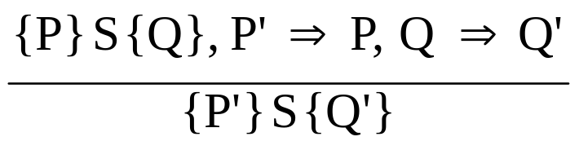
Axiomatic Semantics: Assignment
An axiom for assignment statements
(x = E): {Q_{x->E}} x = E {Q}
The Rule of Consequence:
Copyright © 2012 Addison-Wesley. All rights reserved.
1-<number>

Slide 32

Axiomatic Semantics: Sequences
An inference rule for sequences of the form S1; S2
{P1} S1 {P2}
{P2} S2 {P3}
Copyright © 2012 Addison-Wesley. All rights reserved.
1-<number>

Slide 33
Axiomatic Semantics: Selection
An inference rules for selection
- if B then S1 else S2
{B and P} S1 {Q}, {(not B) and P} S2 {Q}
{P} if B then S1 else S2 {Q}
Copyright © 2012 Addison-Wesley. All rights reserved.
1-<number>

Slide 34
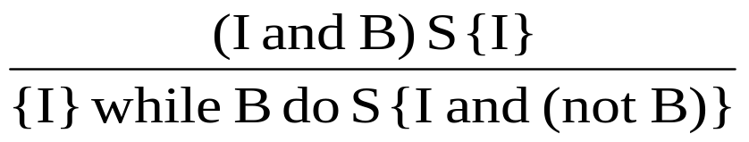
Axiomatic Semantics: Loops
An inference rule for logical pretest loops
{P} while B do S end {Q}
where I is the loop invariant (the inductive hypothesis)
Copyright © 2012 Addison-Wesley. All rights reserved.
1-<number>

Slide 35
Axiomatic Semantics: Axioms
Characteristics of the loop invariant: I must meet the following conditions:
  P => I -- the loop invariant must be true initially
  {I} B {I} -- evaluation of the Boolean must not change the validity of I
  {I and B} S {I} -- I is not changed by executing the body of the loop
  (I and (not B)) => Q -- if I is true and B is false, Q is implied
  The loop terminates -- can be difficult to prove
Copyright © 2012 Addison-Wesley. All rights reserved.
1-<number>

Slide 36
Loop Invariant
The loop invariant I is a weakened version of the loop postcondition, and it is also a precondition.
I must be weak enough to be satisfied prior to the beginning of the loop, but when combined with the loop exit condition, it must be strong enough to force the truth of the postcondition
Copyright © 2012 Addison-Wesley. All rights reserved.
1-<number>

Slide 37
Evaluation of Axiomatic Semantics
Developing axioms or inference rules for all of the statements in a language is difficult
It is a good tool for correctness proofs, and an excellent framework for reasoning about programs, but it is not as useful for language users and compiler writers
Its usefulness in describing the meaning of a programming language is limited for language users or compiler writers
Copyright © 2012 Addison-Wesley. All rights reserved.
1-<number>

Slide 38
Denotation Semantics vs Operational Semantics
In operational semantics, the state changes are defined by coded algorithms
In denotational semantics, the state changes are defined by rigorous mathematical functions
Copyright © 2012 Addison-Wesley. All rights reserved.
1-<number>

Slide 39
Summary
BNF and context-free grammars are equivalent meta-languages
  Well-suited for describing the syntax of programming languages
An attribute grammar is a descriptive formalism that can describe both the syntax and the semantics of a language
Three primary methods of semantics description
  Operation, axiomatic, denotational
Copyright © 2012 Addison-Wesley. All rights reserved.
1-<number>

